Slide 1

Dept. of Computer Science and Engineering BRAC University CSE 341 Team
8086 Hardware Specifications

Slide 2
Lecture References:
Book:
Microprocessors and Interfacing: Programming and Hardware, Author: Douglas V. Hall
The 8086/8088 Family: Design, Programming, And Interfacing, Author: John Uffenbeck.

Slide 3
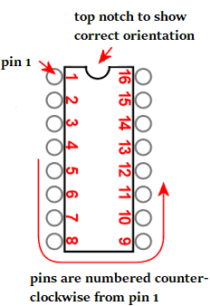
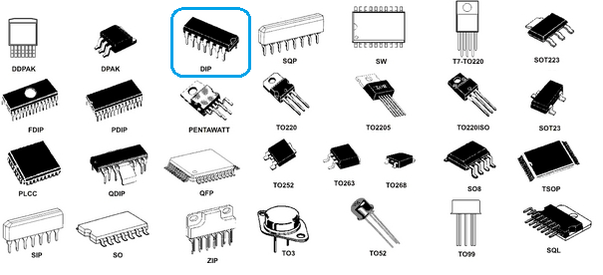
8086 Pin Specification
is a 40-pin DIPs; Dual in-line package
DIP refers to a rectangular housing with two parallel rows of electrical connection pins.
DIPs have a notch on one end to show its correct orientation.
The pins are then numbered as shown in the figure below.

Slide 4
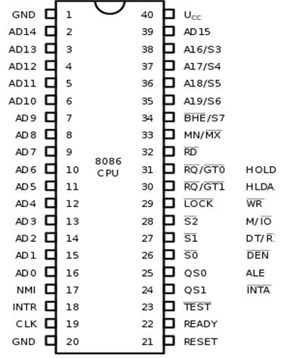
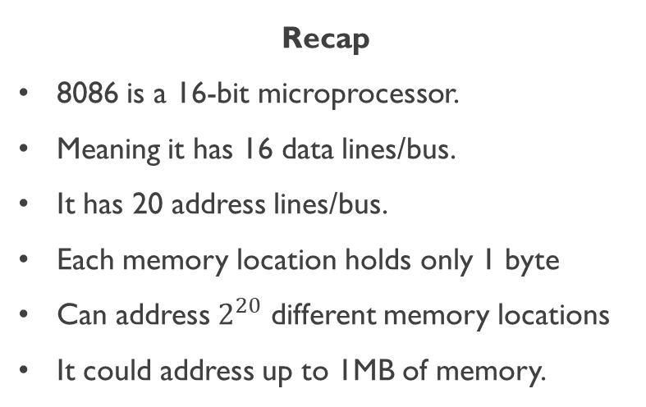
8086 Pin Diagram
Recap
8086 is a 16-bit microprocessor.
Meaning it has 16 data lines/bus.
It has 20 address lines/bus.
Each memory location holds only 1 byte
Can address $2^{20}$ different memory locations
It could address up to 1MB of memory.
min mode
max mode

Slide 5
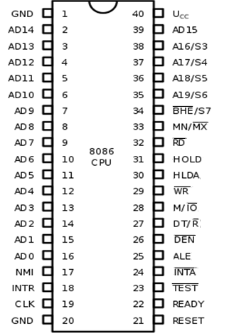
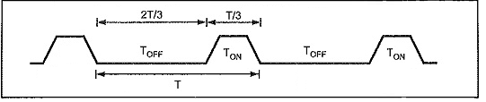
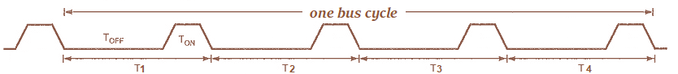
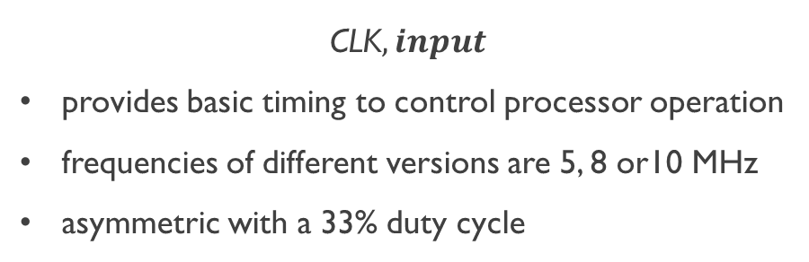
8086 Pin Specification
CLK$,input$
provides basic timing to control processor operation
frequencies of different versions are 5, 8 or10 MHz
asymmetric with a 33% duty cycle

Slide 6
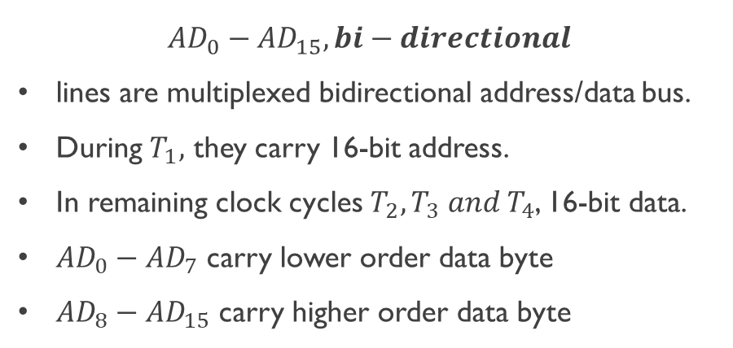
8086 Pin Specification
$${AD}_{0}−{AD}_{15}, bi−directional$$
lines are multiplexed bidirectional address/data bus.
During $T_{1},$ they carry 16-bit address.
In remaining clock cycles $T_{2},T_{3} and T_{4}$, 16-bit data.
${AD}_{0}−{AD}_{7}$ carry lower order data byte
${AD}_{8}−{AD}_{15}$ carry higher order data byte

Slide 7
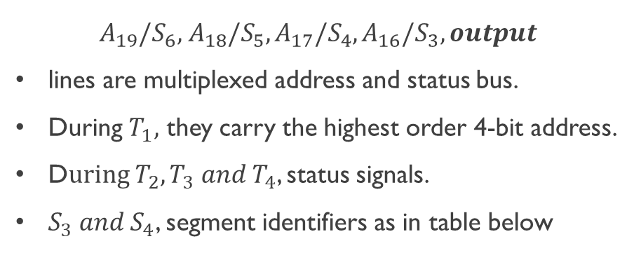
8086 Pin Specification
$$A_{19}/S_{6},{ A}_{18}/S_{5},A_{17}/S_{4},A_{16}/S_{3},output$$
lines are multiplexed address and status bus.
During $T_{1},$ they carry the highest order 4-bit address.
D$uring T_{2},T_{3} and T_{4}$, status signals.
$S_{3} and S_{4}$, segment identifiers as in table below
S4 | S3 | Function
0 | 0 | Extra segment access
0 | 1 | Stack segment access
1 | 0 | Code segment access
1 | 1 | Data segment access

Slide 8
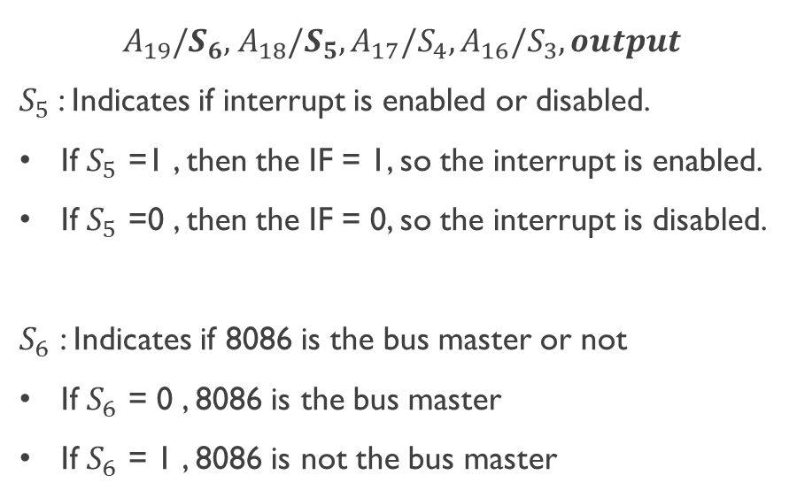
8086 Pin Specification
$$A_{19}/S_{6},{ A}_{18}/S_{5},A_{17}/S_{4},A_{16}/S_{3},output$$
$S_{5}$: Indicates if interrupt is enabled or disabled.
If $S_{5}$ =1 , then the IF = 1, so the interrupt is enabled.
If $S_{5}$ =0 , then the IF = 0, so the interrupt is disabled.
$S_{6}$ : Indicates if 8086 is the bus master or not
If $S_{6}$ = 0 , 8086 is the bus master
If $S_{6}$ = 1 , 8086 is not the bus master

Slide 9
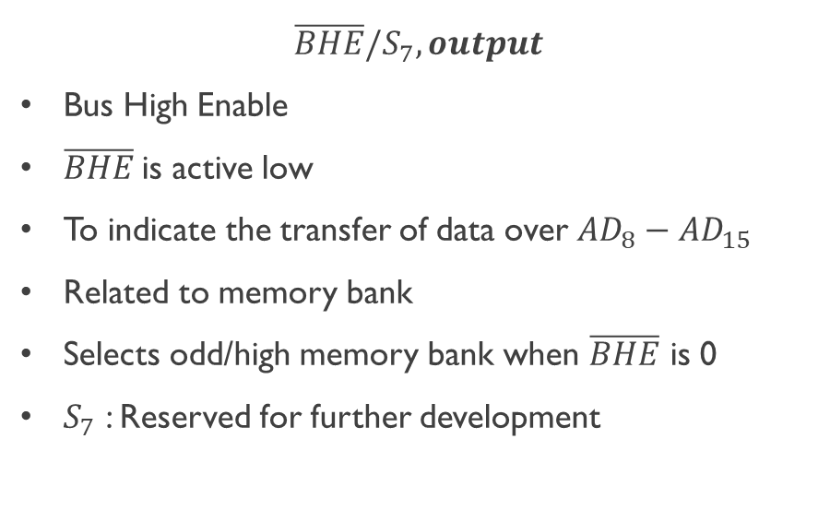
8086 Pin Specification
$$\overline{BHE}/S_{7},output$$
Bus High Enable
$\overline{BHE}$is active low
To indicate the transfer of data over ${AD}_{8}−{AD}_{15}$
Related to memory bank
Selects odd/high memory bank when $\overline{BHE}$ is 0
$S_{7}$ : Reserved for further development

Slide 10
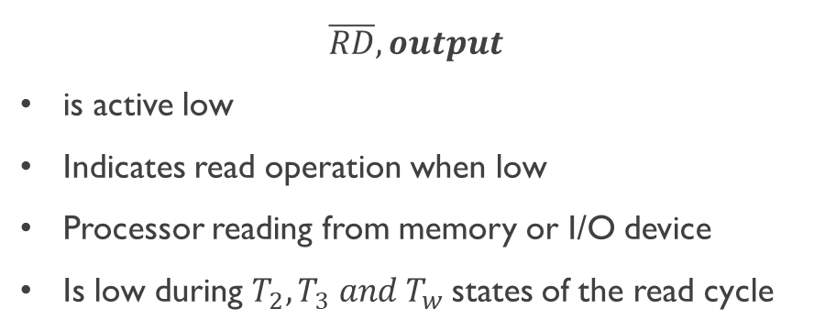
8086 Pin Specification
$$\overline{RD},output$$
is active low
Indicates read operation when low
Processor reading from memory or I/O device
Is low during $T_{2},T_{3} and T_{w}$states of the read cycle

Slide 11
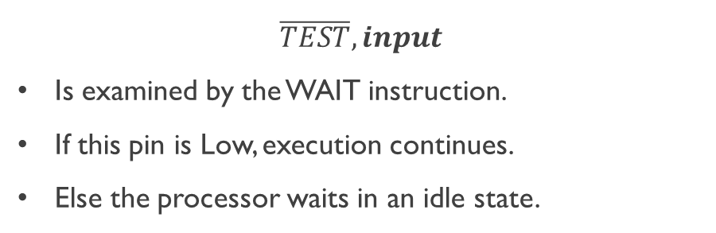
8086 Pin Specification
$$\overline{TEST},input$$
Is examined by the WAIT instruction.
If this pin is Low, execution continues.
Else the processor waits in an idle state.

Slide 12
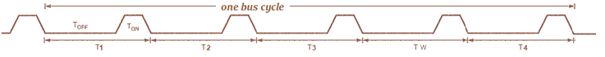
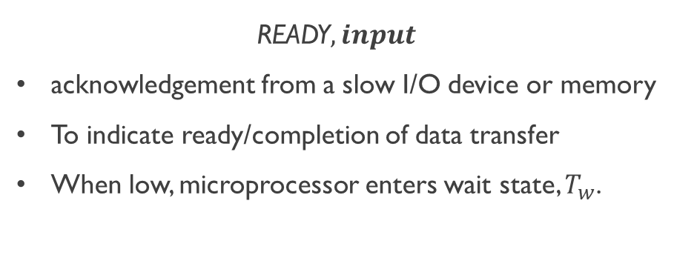
8086 Pin Specification
READY$,input$
acknowledgement from a slow I/O device or memory
To indicate ready/completion of data transfer
When low, microprocessor enters wait state, $T_{w}$.

Slide 13
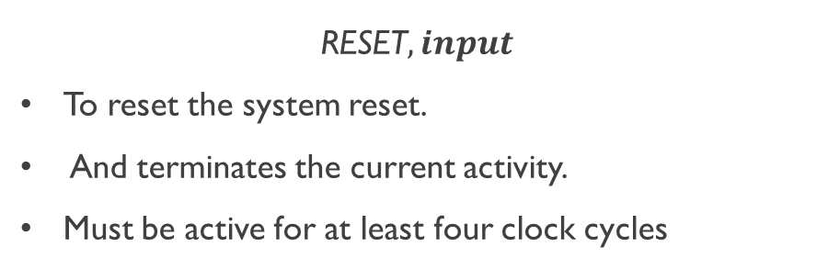
8086 Pin Specification
RESET$,input$
To reset the system reset.
And terminates the current activity.
Must be active for at least four clock cycles

Slide 14
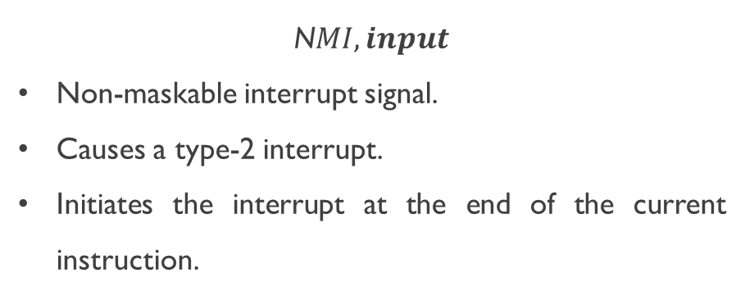
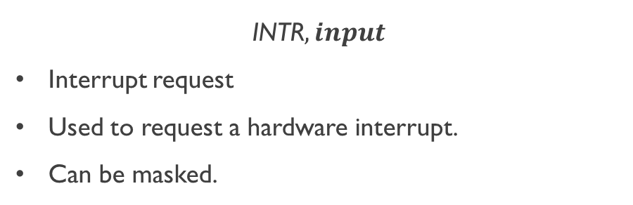
8086 Pin Specification
INTR$,input$
Interrupt request
Used to request a hardware interrupt.
Can be masked.
N$MI,input$
Non-maskable interrupt signal.
Causes a type-2 interrupt.
Initiates the interrupt at the end of the current instruction.

Slide 15
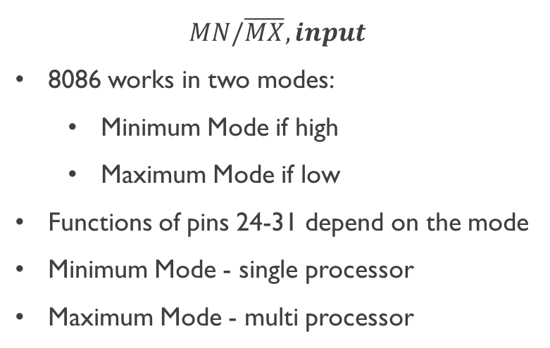
8086 Pin Specification
$$MN/\overline{MX},input$$
8086 works in two modes:
Minimum Mode if high
Maximum Mode if low
Functions of pins 24-31 depend on the mode
Minimum Mode - single processor
Maximum Mode - multi processor
min mode
max mode

Slide 16
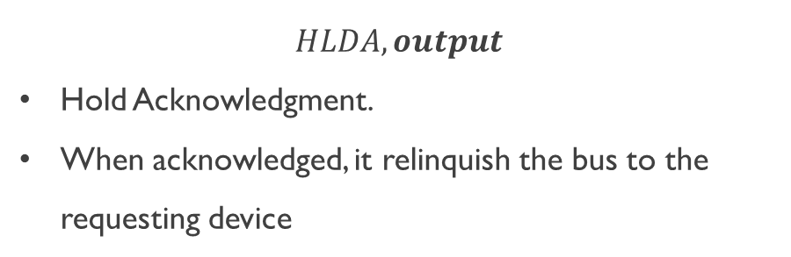

Minimum Mode Pin Specification
HOLD$,input$
To request for bus by another device.
It is an active HIGH signal.
$$HLDA,output$$
Hold Acknowledgment.
When acknowledged, it relinquish the bus to the requesting device

Slide 17
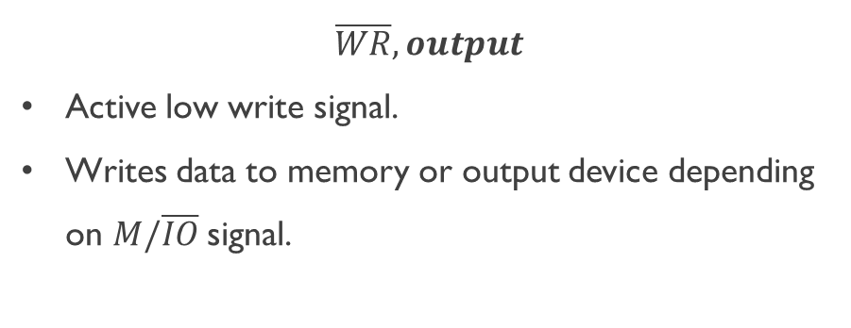
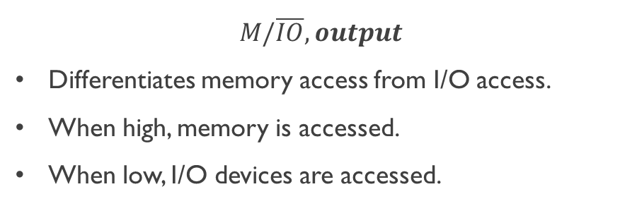
Minimum Mode Pin Specification
$$\overline{WR},output$$
Active low write signal.
Writes data to memory or output device depending on $M/\overline{IO}$signal.
$$M/\overline{IO},output$$
Differentiates memory access from I/O access.
When high, memory is accessed.
When low, I/O devices are accessed.

Slide 18
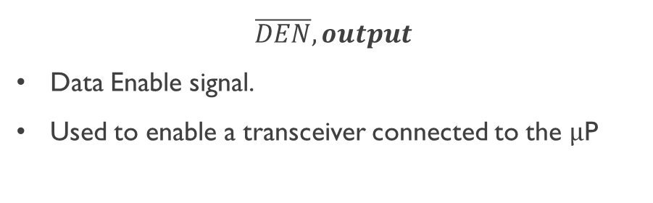
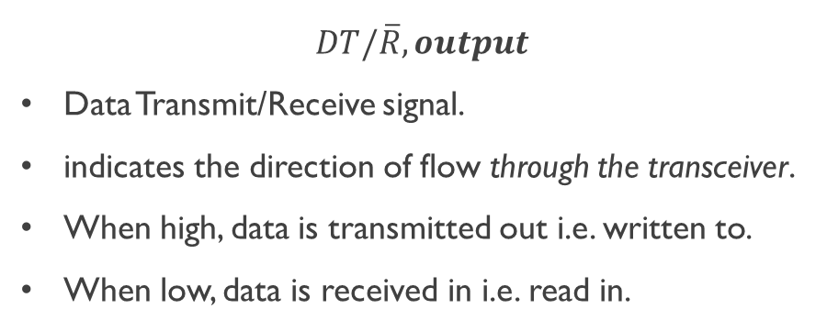
Minimum Mode Pin Specification
$DT/\overline{R}, output$
Data Transmit/Receive signal.
indicates the direction of flow through the transceiver.
When high, data is transmitted out i.e. written to.
When low, data is received in i.e. read in.
$\overline{DEN}, output$
Data Enable signal.
Used to enable a transceiver connected to the $μ$P

Slide 19
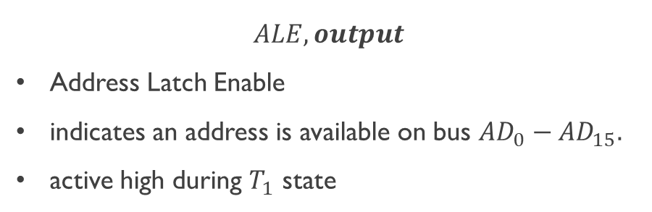
Minimum Mode Pin Specification
$$ALE,output$$
Address Latch Enable
indicates an address is available on bus ${AD}_{0}−{AD}_{15}.$
active high during $T_{1}$ state

Slide 20
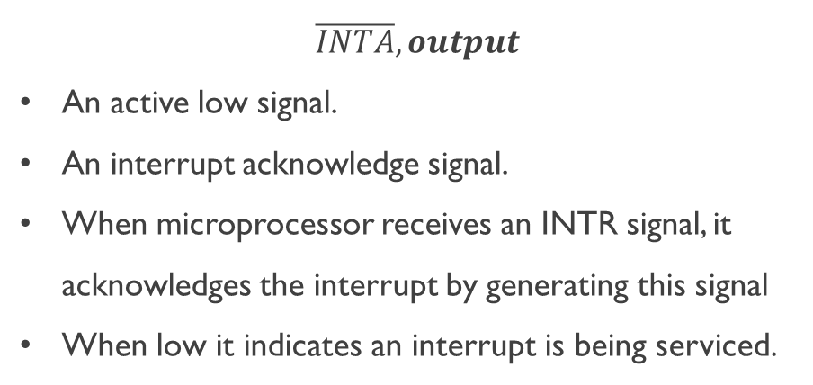
Minimum Mode Pin Specification
$\overline{INTA},output$
An active low signal.
An interrupt acknowledge signal.
When microprocessor receives an INTR signal, it acknowledges the interrupt by generating this signal
When low it indicates an interrupt is being serviced.

Slide 21
Dept. of Computer Science and Engineering BRAC University CSE 341 Team
8086 Maximum Mode Pins

Slide 22
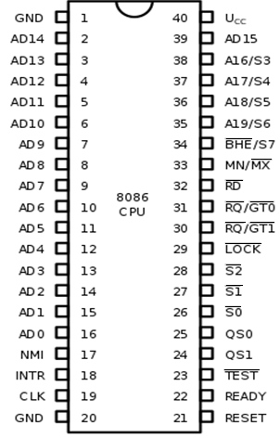
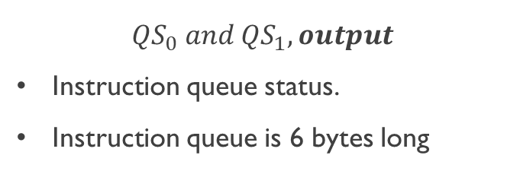
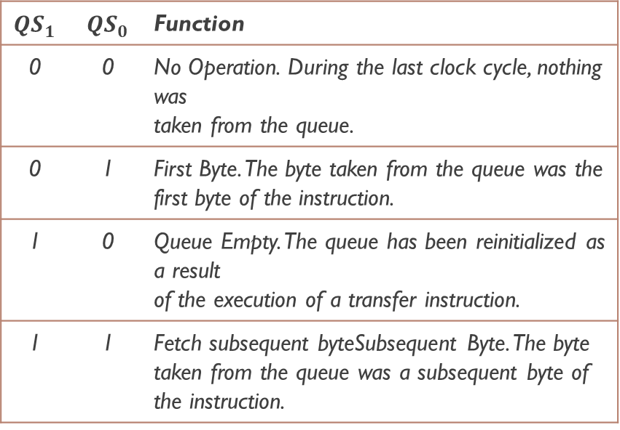
Maximum Mode Pin Specification
${QS}_{0} and QS_{1},output$
Instruction queue status.
Instruction queue is 6 bytes long
$${QS}_{1}$$ | $${QS}_{0}$$ | Function
0 | 0 | No Operation. During the last clock cycle, nothing was taken from the queue.
0 | 1 | First Byte. The byte taken from the queue was the first byte of the instruction.
1 | 0 | Queue Empty. The queue has been reinitialized as a result of the execution of a transfer instruction.
1 | 1 | Fetch subsequent byteSubsequent Byte. The byte taken from the queue was a subsequent byte of the instruction.

Slide 23
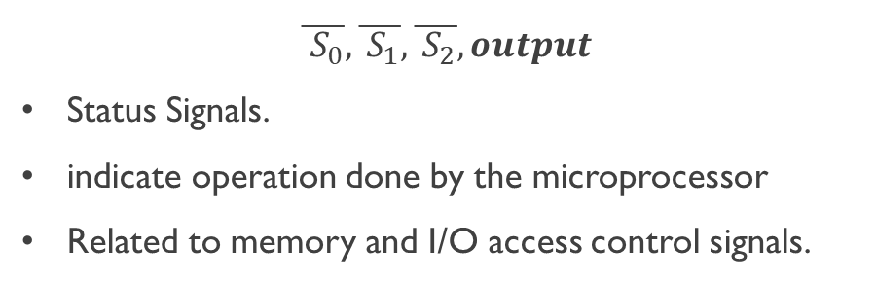
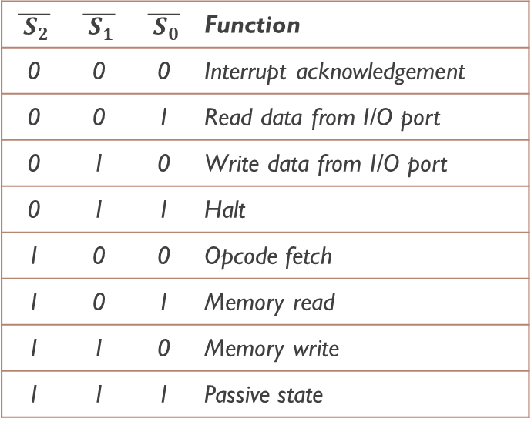
Maximum Mode Pin Specification
$\overline{{ S}_{0}},\overline{{ S}_{1}},\overline{{ S}_{2}}, output$
Status Signals.
indicate operation done by the microprocessor
Related to memory and I/O access control signals.
$$\overline{{ S}_{2}}$$ | $$\overline{{ S}_{1}}$$ | $$\overline{{ S}_{0}}$$ | Function
0 | 0 | 0 | Interrupt acknowledgement
0 | 0 | 1 | Read data from I/O port
0 | 1 | 0 | Write data from I/O port
0 | 1 | 1 | Halt
1 | 0 | 0 | Opcode fetch
1 | 0 | 1 | Memory read
1 | 1 | 0 | Memory write
1 | 1 | 1 | Passive state

Slide 24
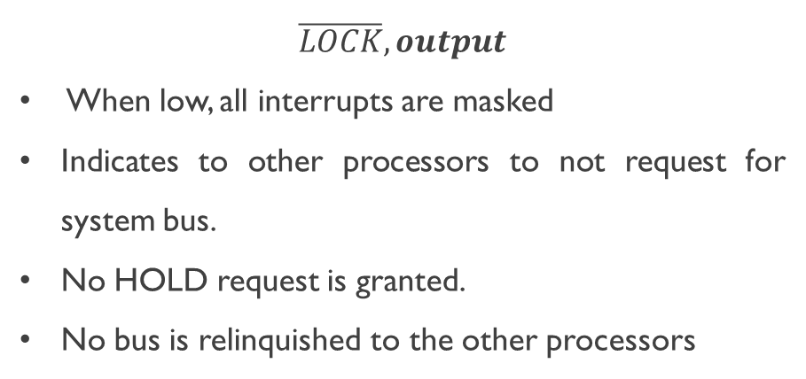
Maximum Mode Pin Specification
$\overline{LOCK}, output$
When low, all interrupts are masked
Indicates to other processors to not request for system bus.
No HOLD request is granted.
No bus is relinquished to the other processors

Slide 25
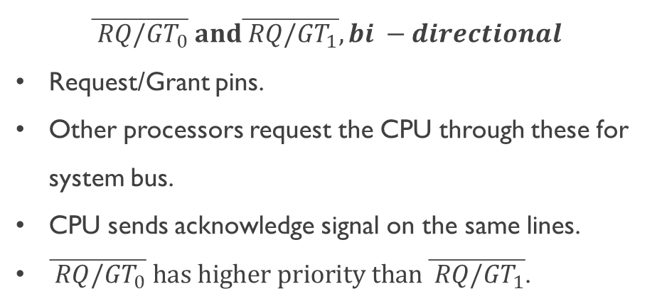
Maximum Mode Pin Specification
$\overline{{ RQ/GT}_{0}} and\overline{{ RQ/GT}_{1}}, bi −directional$
Request/Grant pins.
Other processors request the CPU through these for system bus.
CPU sends acknowledge signal on the same lines.
$\overline{{ RQ/GT}_{0}} has higher priority than \overline{{ RQ/GT}_{1}}$.

Slide 26
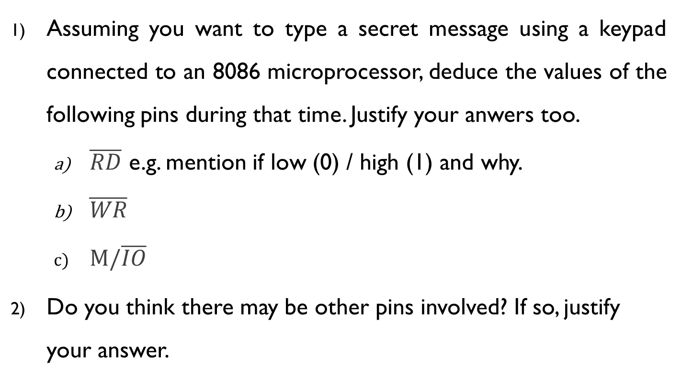
QUIZ
Assuming you want to type a secret message using a keypad connected to an 8086 microprocessor, deduce the values of the following pins during that time. Justify your anwers too.
$\overline{RD}$ e.g. mention if low (0) / high (1) and why.
$\overline{WR}$
$M/\overline{IO}$
Do you think there may be other pins involved? If so, justify your answer.

Slide 27
Dept. of Computer Science and Engineering BRAC University CSE 341 Team
8086 Clocks & Timing Diagrams

Slide 28
Microprocessor Operation
Fetch
Decode
Execute
An instruction e.g. MOV [7531h], AX ; SUB CH, [0ABCh] etc
The time a µP requires to complete fetch-(decode)-execute operation of a single instruction is known as Instruction Cycle

Slide 29
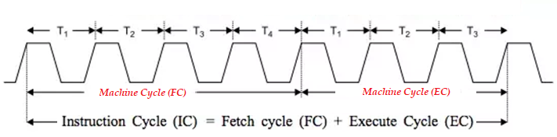
Microprocessor Operation
Instruction Cycle consists of one or more Machine Cycles
A basic µP operation such as reading/writing a byte from or to memory or I/O port is called a Machine/Bus cycle

Slide 30
Microprocessor Operation
A Machine (bus) cycle consists of at least four clock cycles, called T states.
One cycle of a clock is called a State
Each read or write operation takes 1 bus cycle.

Slide 31
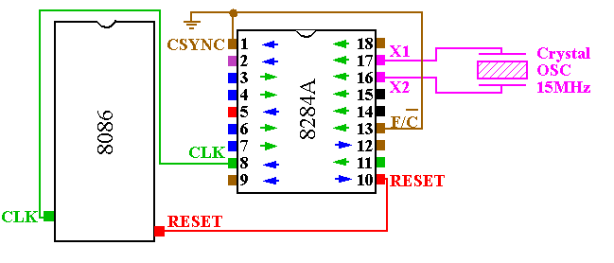
Clock Generation
Clock generator circuit is 8284A and connected to pin 19 (CLK) of 8086.

Slide 32
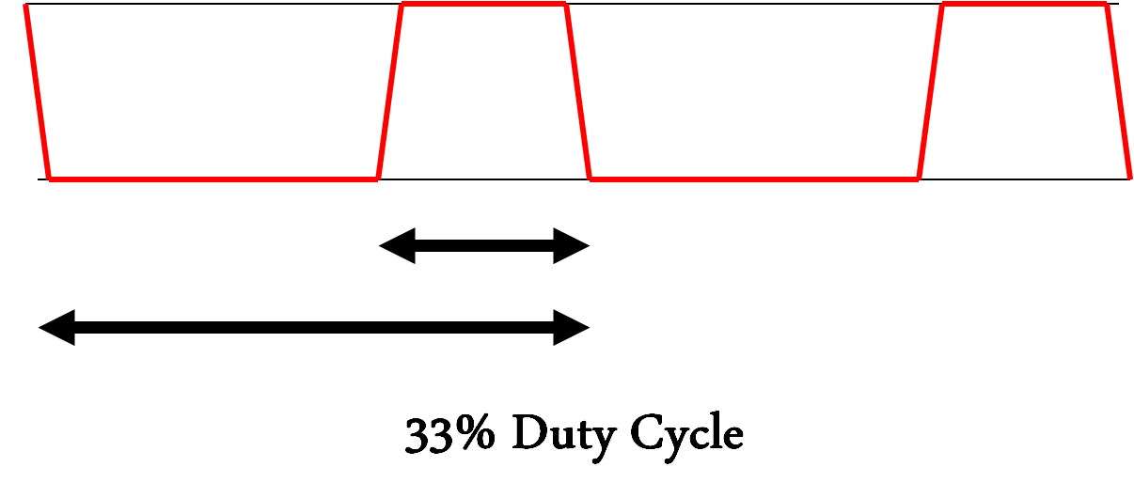
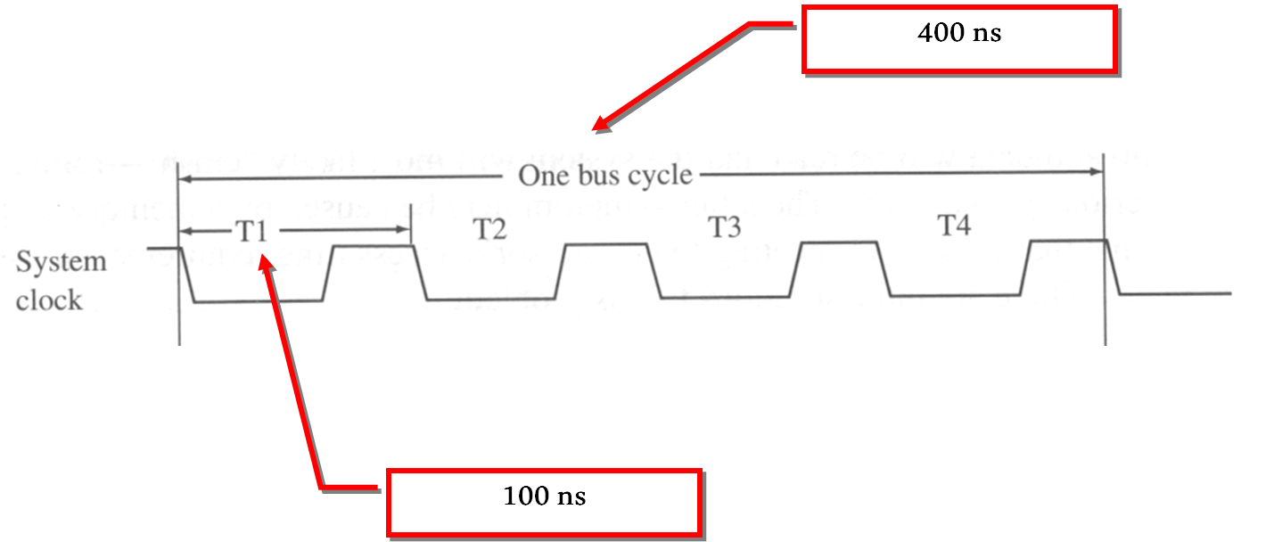


System Clock Concept
8086 is found to operate in between 5 to 10 Mhz.
An 8086 running at 5MHz, its clock pulses will be of 200ns and it would take 800ns for a complete bus cycle.
$$T_{off}$$
$$T_{on}$$
For a 10MHz 8086, its clock pulses will be of 100ns and it would take 400ns for a complete bus cycle.

Slide 33
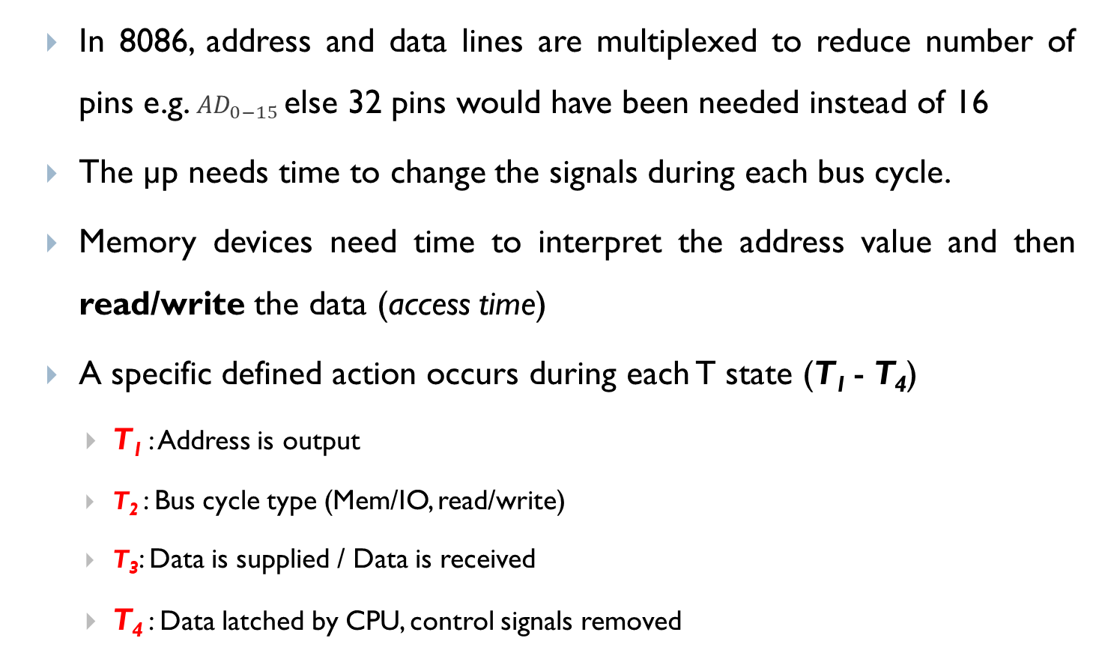
Clock States - Why are there T states?
In 8086, address and data lines are multiplexed to reduce number of pins e.g. ${AD}_{0−15}$else 32 pins would have been needed instead of 16
The µp needs time to change the signals during each bus cycle.
Memory devices need time to interpret the address value and then read/write the data (access time)
A specific defined action occurs during each T state (T₁ - T₄)
T₁ : Address is output
T₂ : Bus cycle type (Mem/IO, read/write)
T₃: Data is supplied / Data is received
T₄ : Data latched by CPU, control signals removed

Slide 34
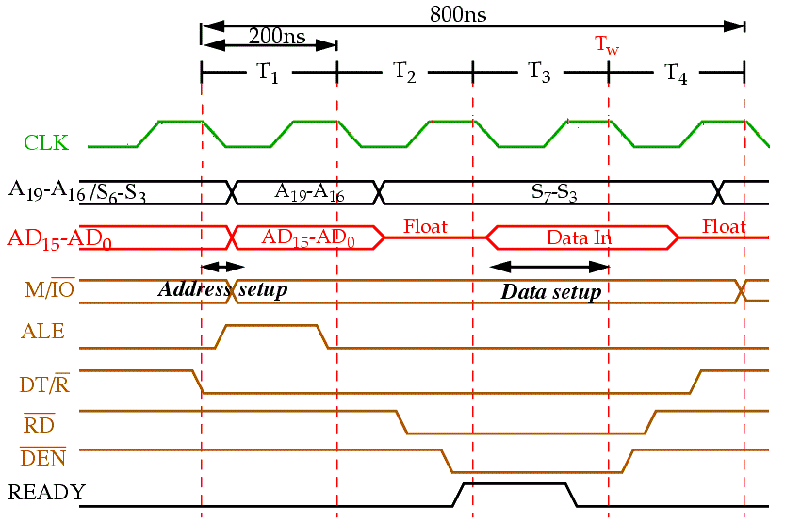
READ BUS Timing (Complete BUS Cycle)
T₁: Address is output
Address of memory is sent out by 8086 via address bus
Used Control signals: ALE, DT/R’, M/IO’ shows some output

Slide 35
READ BUS Timing (Complete BUS Cycle)
T₂: Bus cycle type (MEMORY/IO, READ/WRITE)
8086 issues either RD’ or WR’ and DEN’
In case of WRITE (WR) operation, data to be written appear on data bus

Slide 36
READ BUS Timing (Complete BUS Cycle)
T₃: Data is supplied
READY is sampled at the end of T2
If READY is low, T3 becomes a wait state (Tw), means no operation (NOP).
In READ bus cycle data bus is sampled at end of T3

Slide 37
READ BUS Timing (Complete BUS Cycle)
T₄: Data latched by µP, control signals removed
All bus signals deactivated in preparation for next bus cycle
µP sampled data bus for data that read from M or I/O

Slide 38
Clock States
A specific, defined action occurs during each T states (T₁ – T₄)
T₁: Address is output
Address of memory is sent out by 8086 via address bus
Used Control signals: ALE, DT/R’, M/IO’ shows some output
T₂: Bus cycle type (MEMORY/IO, READ/WRITE)
8086 issues either RD’ or WR’ and DEN’
In case of WRITE (WR) operation, data to be written appear on data bus

Slide 39
Clock States
T₃: Data is supplied
READY is sampled at the end of T₂
If READY is low, T₃ becomes a wait state (T_{w}), means no operation (NOP).
In READ bus cycle data bus is sampled at end of T₃
T₄: Data latched by µP, control signals removed
All bus signals deactivated in preparation for next bus cycle
µP sampled data bus for data that read from M or I/O
At trailing edge of WR’, transfer data to M or I/O

Slide 40
8086 Ready pin
The READY input is controlled to insert “Wait states” into the timing of the microprocessor for slower memory and I/O components..
If the READY pin is at a logic 0 level, the micro-processor enters into wait states and remains idle.
When it is high (logic 1), it indicates that the device is ready to transfer data.
A wait state is a situation in which a computer processor is waiting for the completion of some event before resuming activity.
A program or process in a wait state is inactive for the duration of the wait state.

Slide 41
Ready pin and Wait state
When a computer processor works at a faster clock speed than the random access memory ( RAM ) that sends it instructions, it is set to go into a wait state for one or more clock cycles so that it is synchronized with RAM speed. In general, the more time a processor spends in wait states, the slower the performance of that processor.
Wait states are a pure waste for a processor's performance. Modern designs try to eliminate or hide them using a variety of techniques: CPU caches, instruction pipelines, instruction prefetch, simultaneous multithreading and others.

Slide 42
Thank You
Questions are welcome in the discussion class

